Slide 1

Mi Barrio,
Mi Pueblo
Paint a neighborhood, hometown, or special place that has shaped your story.
ADULT CREATIVE STORYTELLER SATURDAY
2-HOUR FACILITATOR LESSON
Every story matters. Every voice belongs.
Creative Storyteller Studio Café
Notes:
Welcome participants as they arrive. Invite everyone to choose a comfortable seat and notice the materials. Say: Today we will paint a place that lives in our memory. Artistic experience is not required. Sharing is always by choice.

Slide 2
WORKSHOP MAP
Our two-hour journey
10
15
15
50
15
10
5
min
min
min
min
min
min
min
Welcome + settle
Story + memory
Plan + sketch
Paint
Write
Optional sharing
Close
Facilitator intention
Create a calm rhythm. Protect quiet painting time. Invite memories without asking anyone to explain or disclose more than they choose.
CREATIVE STORYTELLER SATURDAYS
02
Notes:
Review the schedule briefly. Emphasize that the longest block is for painting. Keep transitions gentle and visible. Give a five-minute notice before each change.

Slide 3
PREPARE
Gather your materials
Painting
Planning
Story details
• 16 × 20 canvas or heavy paper
• Acrylic paint
• Small, medium, and wide brushes
• Water cup
• Palette or paper plate
• Pencil and eraser
• Scrap paper
• Printed personal photos, optional
• Painter’s tape, optional
• Apron or old shirt
• Paint pens or markers, optional
• Collage paper, optional
• A meaningful word, date, name, or phrase
• Paper towels
CREATIVE STORYTELLER SATURDAYS
03
Notes:
Set out core supplies before the session. Photos are optional and should belong to the participant or be used with permission. Encourage participants to work with what is available instead of waiting for perfect materials.

Slide 4
WELCOME
Creative permission
No perfect painting
Notice, don’t judge
Share by choice
This is a story space, not a test. Your marks can be loose, symbolic, layered, or simple.
Use curiosity with your own work and with the work of others.
You may tell the whole story, one sentence, or simply share your title.
You are the keeper of your story.
CREATIVE STORYTELLER SATURDAYS
04
Notes:
Read the three agreements aloud. Ask for a simple nod of consent. If the group has additions, capture only agreements that support safety, respect, and creative freedom.

Slide 5
GROUNDING
Arrive in the room
1
Place both feet on the floor.
2
Take one slow breath in and a longer breath out.
3
Picture yourself arriving at a place that matters to you.
4
Notice one color, one sound, and one feeling.
Eyes may be open or softly lowered.
CREATIVE STORYTELLER SATURDAYS
05
Notes:
Guide this slowly for about two minutes. Do not require closed eyes. Let participants know they can choose a peaceful or ordinary place rather than a difficult memory.

Slide 6
STORY INVITATION
What is Mi Barrio, Mi Pueblo?
A neighborhood, hometown, gathering place, landscape, or corner of the world that helped shape who you are.
It can be real
It can be remembered
It can be symbolic
A street, house, plaza, church, school, kitchen, garden, or desert trail.
A place that changed, moved, or lives differently in memory now.
A place built from feeling, family stories, and imagination.
CREATIVE STORYTELLER SATURDAYS
06
Notes:
Introduce barrio and pueblo as spacious words. Invite each participant to define belonging for themselves. Avoid assuming that home is simple, safe, or tied to one location.

Slide 7
REMEMBER
Walk through the memory
What do you notice?
Who is present?
What remains?
What can you see?
What can you hear?
What scent, texture, weather, or taste belongs there?
Who is beside you?
Whose voice do you remember?
Is there an animal, object, or tradition that belongs in the scene?
What happened there?
What feeling returns?
What do you want the painting to protect or honor?
CREATIVE STORYTELLER SATURDAYS
07
Notes:
Offer the prompts one at a time. Allow a few seconds of silence after each. Participants can jot words or make tiny thumbnail sketches. Remind them they do not need to answer every question.

Slide 8
FOCUS
Choose one place, one moment
Complete these sentences
SMALLER STORY
STRONGER FOCUS
The place I am painting is…
The moment I want to hold is…
The feeling I want the colors to carry is…
One detail I do not want to forget is…
You do not need to paint the entire neighborhood. Choose the doorway, person, object, sky, path, or gathering that carries the story.
CREATIVE STORYTELLER SATURDAYS
08
Notes:
Give participants five quiet minutes to choose. If someone feels stuck, ask: If this place were a postcard, what would be in the center? Encourage a manageable moment rather than a complete history.

Slide 9
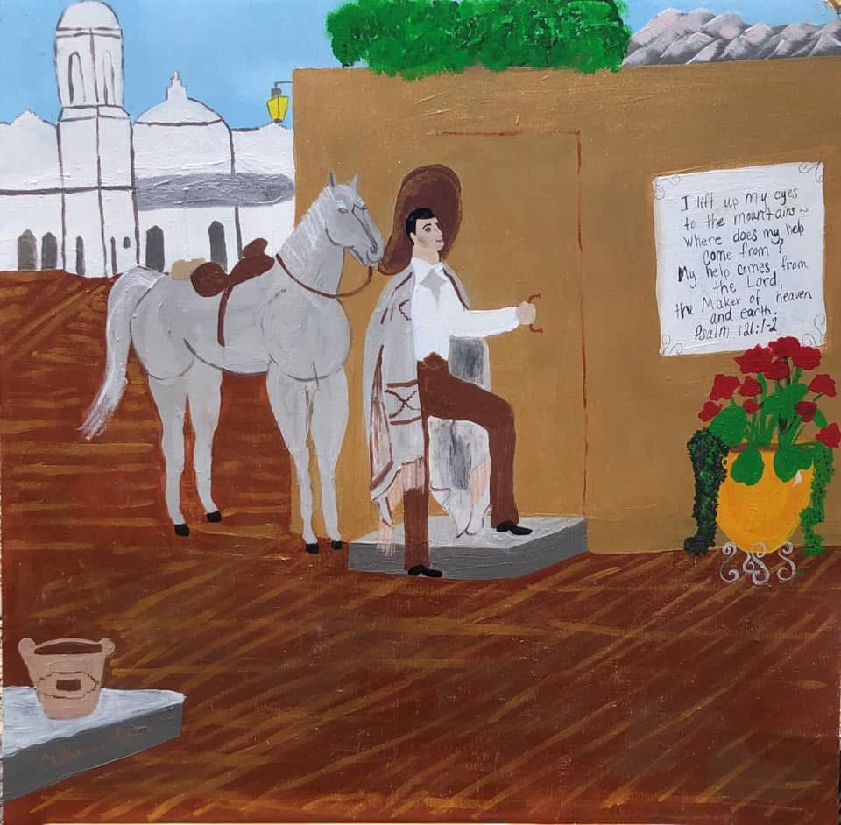
LOOK CLOSELY
Symbols carry story
White horse
Strength, movement, protection, memory, or something entirely personal.
Church + mountain
Place, faith, direction, family history, or a landmark that guides the eye.
Flowers + written words
Love, remembrance, devotion, celebration, or a voice included inside the painting.
CREATIVE STORYTELLER SATURDAYS
09
Notes:
Use this painting as an example, not a template to copy. Ask participants what they notice before offering possible meanings. State clearly that symbols belong to the artist, and meanings can differ across people and cultures.

Slide 10
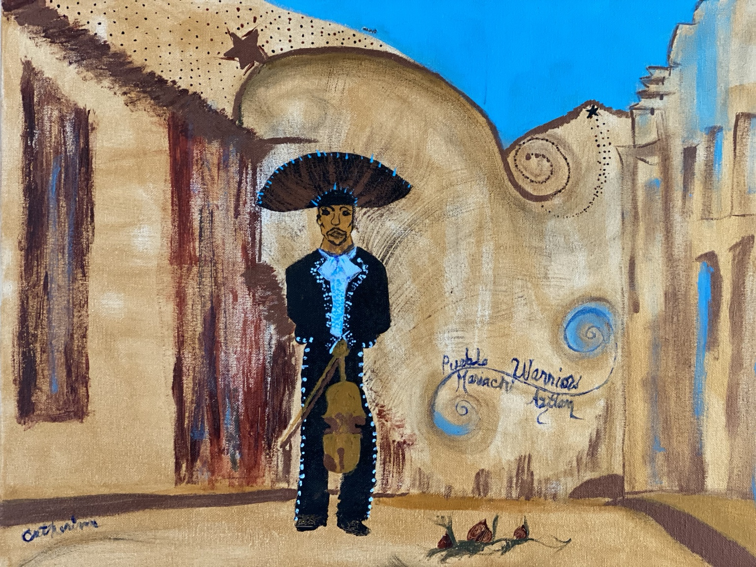
CHOOSE A PALETTE
Let color hold the feeling
Choose 3–5 main colors
CALM / OPEN
WARM / REMEMBERED
ROOTED / ALIVE
DEEP / REFLECTIVE
These are invitations, not rules. Your colors can mean something different.
CREATIVE STORYTELLER SATURDAYS
10
Notes:
Invite participants to mix a small palette before painting. Ask: Which color feels like this memory? Which color creates distance or closeness? Reinforce that color meanings are personal rather than universal.

Slide 11
PLAN
Sketch the bones of the story
1
2
3
HORIZON
LARGE SHAPES
FOCAL POINT
Where do earth, buildings, or walls meet the sky?
Block in the biggest areas before small details.
Choose the person, doorway, object, path, or symbol the eye meets first.
Sketch lightly. Leave room for the painting to surprise you.
CREATIVE STORYTELLER SATURDAYS
11
Notes:
Demonstrate a very light, simple sketch for no more than three minutes. Keep the emphasis on large shapes and placement. Tell participants that paint can change the plan.

Slide 12
CREATE · 50 MINUTES
Paint from background to story
01
BACKGROUND
Sky, wall, earth, room, or atmosphere
02
MIDDLE
Buildings, landscape, paths, tables, trees
03
FOCAL POINT
Person, animal, doorway, object, or symbol
04
STORY DETAILS
Words, pattern, light, texture, names, dates
Pause halfway: step back, soften your shoulders, and look before adding more.
CREATIVE STORYTELLER SATURDAYS
12
Notes:
Protect a full 50-minute painting block. Give minimal instruction while people work. At the halfway point, invite everyone to stand or lean back and look. Offer help by asking questions rather than repainting anyone's work.

Slide 13
STORY · 15 MINUTES
Write beside the painting
Choose one beginning
In this place, I learned…
I remember the sound of…
What I want you to notice is…
This place still lives in me because…
If this painting could speak, it would say…
Write a title, a few lines, or a full paragraph. Spelling and grammar do not matter here.
CREATIVE STORYTELLER SATURDAYS
13
Notes:
Invite writing after most paint is complete. Participants may write on separate paper, on the back of a paper artwork, or add a short phrase to the front. Offer dictation support if helpful, but do not edit their voice.

Slide 14
OPTIONAL CIRCLE · 10 MINUTES
Share only what feels right
A simple way to share
PASSING
IS PARTICIPATING
1. My title is…
2. The place or moment is…
3. One detail I want you to notice is…
4. The feeling or meaning I am carrying forward is…
You may share your title only, hold up your painting silently, or pass.
CREATIVE STORYTELLER SATURDAYS
14
Notes:
Model a short share first. Ask listeners to receive each story without interpretation, correction, or advice. Use appreciation such as thank you for sharing rather than evaluation of artistic skill.

Slide 15
Before you leave…
What did you remember?
What did you release?
What do you want to carry with you?
Every story matters. Every voice belongs.
Awakening Purpose. Inspiring Legacy.
Notes:
Invite one final breath. Ask participants to look at their painting and silently thank the place, person, or memory that guided them. Close with: Your story belongs to you. Thank you for bringing it into the room today.

